Slide 1



RiskEx Real-Time Derivatives Trading and Analytics Bot
RiskEx Real-Time Derivatives Trading and Analytics Bot
Data ^{X}
Data ^{X}
Elias Castro Hernandez, Ling Zhou, Manana Hakobyan, Ran Jiang, Raghav Mathur
Elias Castro Hernandez, Ling Zhou, Manana Hakobyan, Ran Jiang, Raghav Mathur

Slide 2
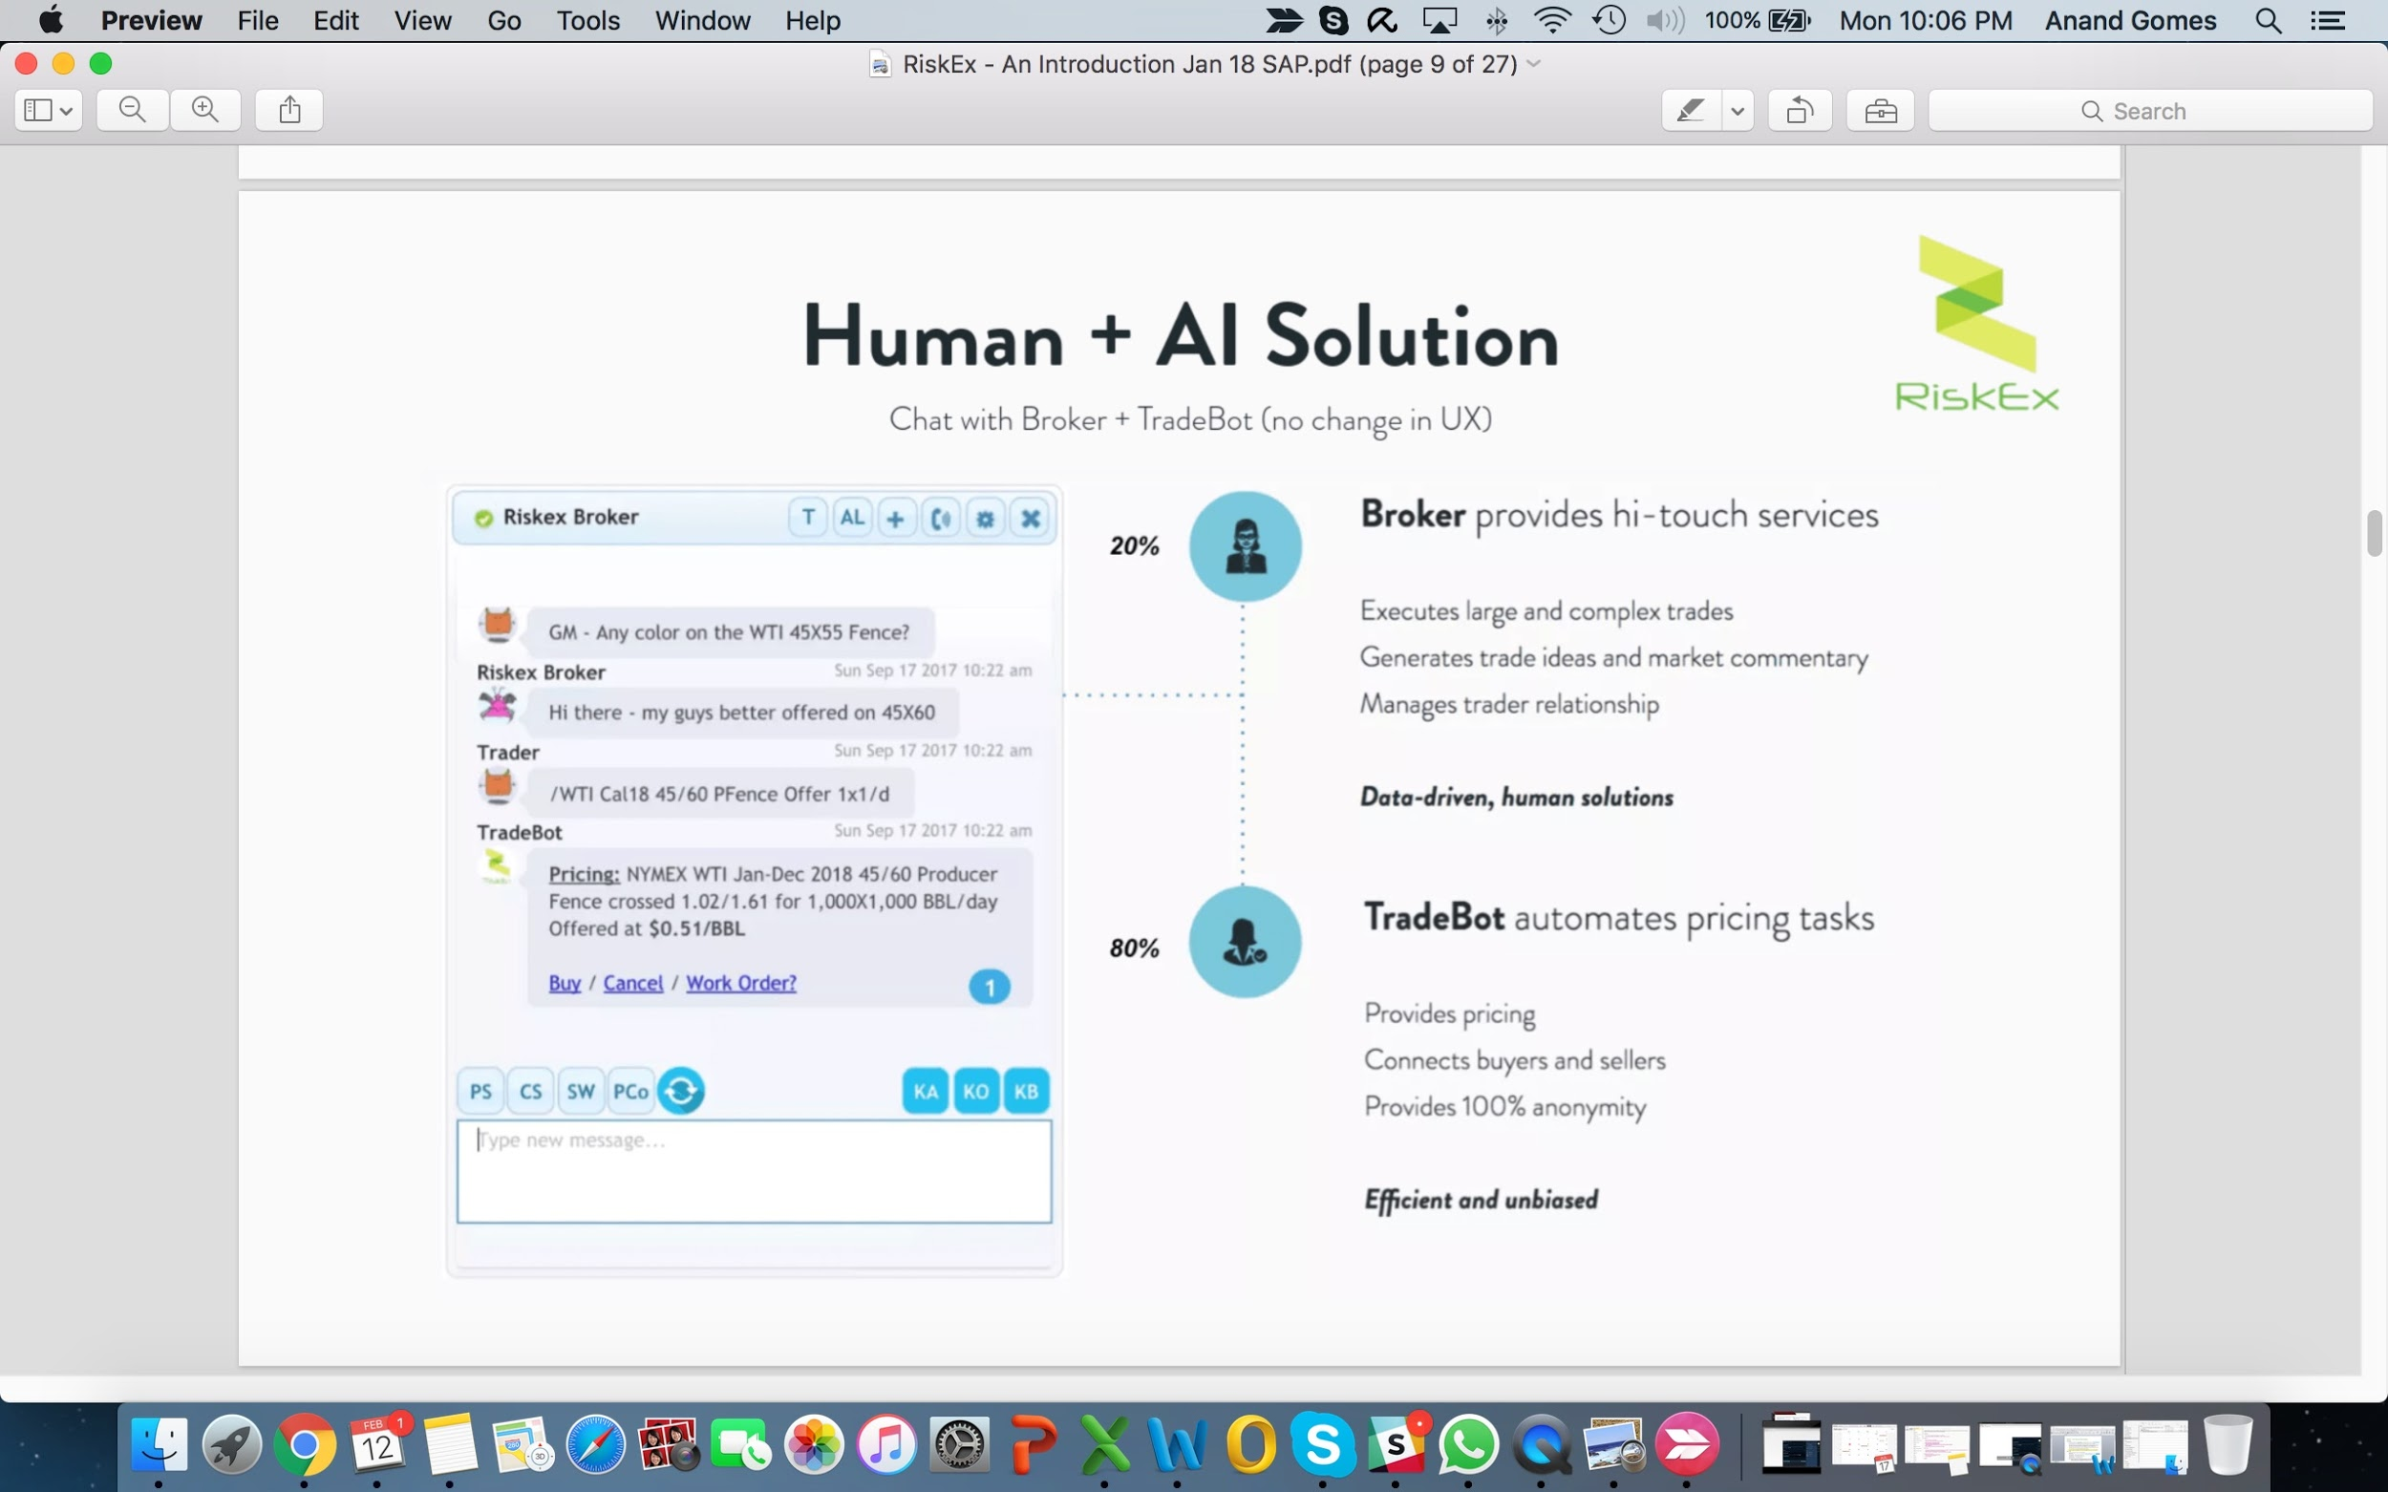

Chat Interface
Chat-based platform between traders and brokers.
ChatBot supplements the human interaction, providing smart market making.
Notes:
def: market maker
a company or an individual that quotes both a buy and a sell price in a financial instrument or commodity held in inventory, hoping to make a profit on the bid-offer spread -- on a regular and continuous basis at a publicly quoted price.

Slide 3
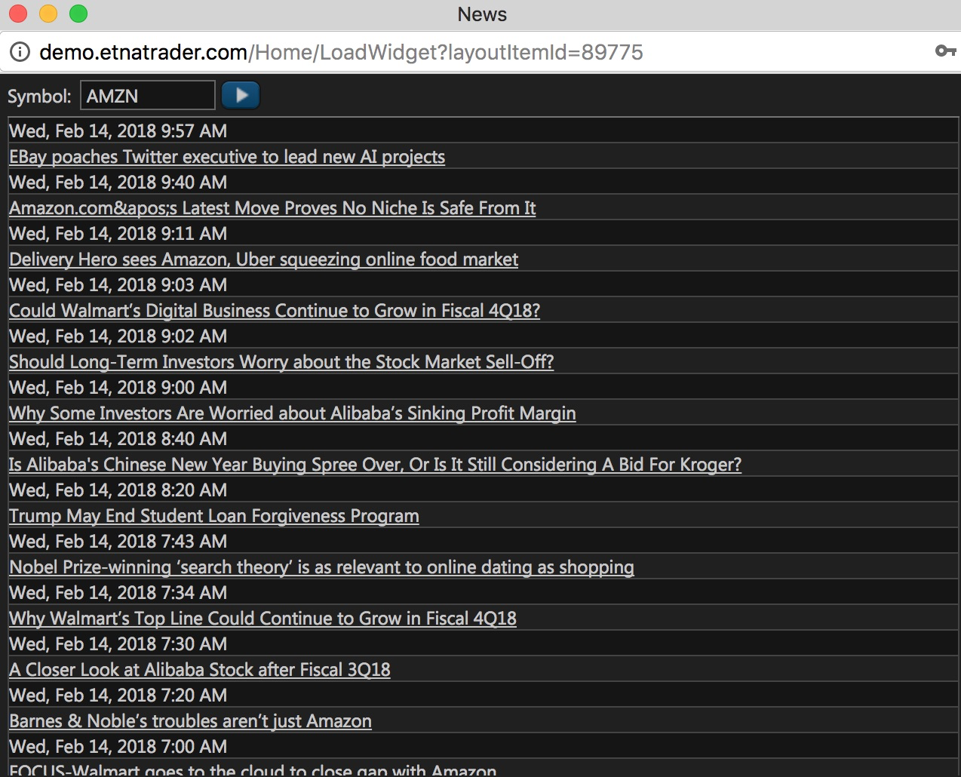

RiskEx - Widget Based Content Delivery (Key Features)
NewsBot:
User can construct a “News Search” through Keywords, Themes, Asset Tickers, Regions, etc. -- moreover user can “Whitelist” results.
Newsbot delivers this content in real time -- within the chat application itself.
Newsbot’s goal is to spur real-time interactions by automating content delivery.
DataBot:
Scrapes, cleans, and summarizes derivative trade-data into human readable updates.
Delivers content via chat, and can interact with existing product (TradeBot) to provide on-the-spot price quotes.

Slide 4
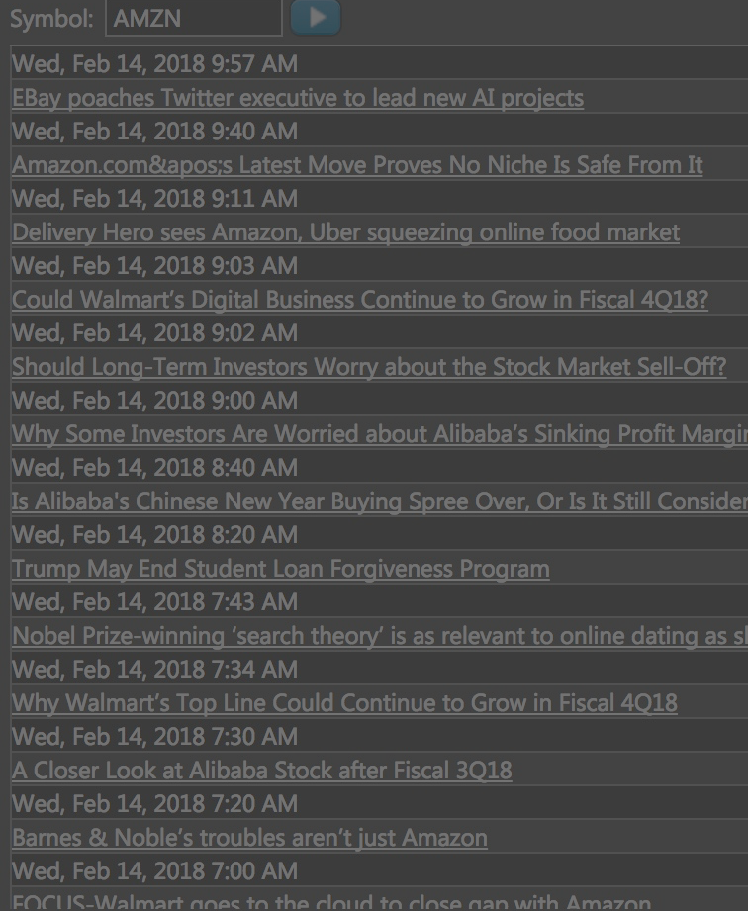
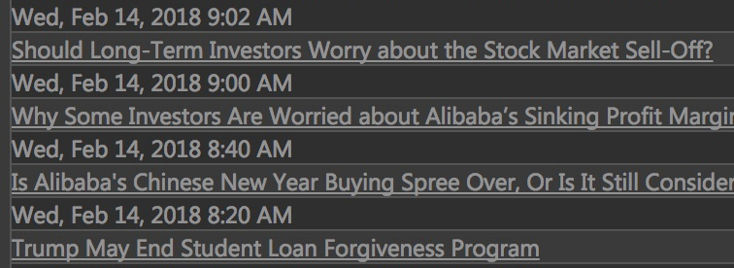
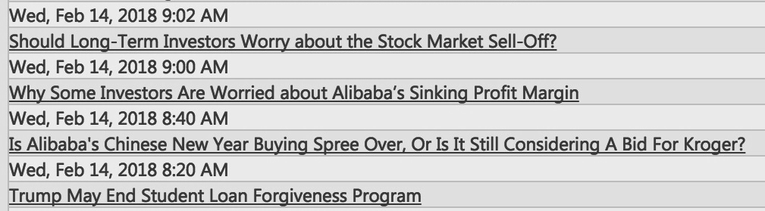

RiskEx - Chat-Based Derivatives Trading and Analysis
Key features:
NewsBot - Automatically shares relevant, verified news on specified assets
DataBot - Analyzes and Summarizes transactions in real-time. Alerts traders to relevant updates.
User requirements:
Accuracy
Relevance
Time-sensitivity

Slide 5

Project Breakdown: Sub-Projects and Components
NewsBot
DataBot
Pull data from existing newsfeeds.
Allow for user-inputted filters for the data.
Collect trade data from online data dumps.
Clean, organize, and store data based on canonical terminology and industry lingo.
Automate Data Science processes on RiskEx data stores.
Allow for filtering of data based on user-specified criteria.
Alert users to breaking news in the chat interface.
Automatically vet sources and publications based on user feedback, and network effects.
Recommend related and relevant news based on user activity, and network effects.
Automatically share real-time trades in the chatbot based on user filtering criteria.
Identify strategies being executed, and alert applicable traders to influential activity.
Automatically vet sources and publications based on the resulting trading activity of the community, in response to the article.

Slide 6

Sample Architecture (SA) and Data Model (DM)
Compute including test, train, split
Possible Inputs Code Blocks
Algorithm options with news matrix prediction and classification for relevance and ranking
| Natural Language |
| State Space Feature Extraction |
Possible Output Code Blocks
Web News
“Sources” list
“Sources” list
Download
Email Alert
Pandas:
Short Term Storage
Email Alert
Stream
Social Net
Newsbot
Newsbot
Long Term Storage: SQL and File Formats
(JSON, CSV, Excel)
…
…
User Searches
Control Decision
Bot
learns | automates | recommends
Feedback from user response
(clicking/sharing)

Slide 7

Initial Roadmap
Week 1
Understand the markets.
Understand the problem.
Analyze existing solutions & products.
Week 2
Develop initial MVP/prototype for NewsBot.
Test & Compare to existing tools and manual methods.
Week 3
Implement recommendation and filtering systems for NewsBot.
Test & Compare to existing tools and manual methods.
Week 4
Integrate NewsBot with ChatBot.
Start learning rules for cleaning derivative data.
Week 5
Develop initial MVP/prototype for DataBot.
Test & Compare to existing tools and manual methods.
Week 6+
Implement recommendation and filtering systems for DataBot.
Integrate both systems into ChatBot.
Test & Compare.

